Slide 1

Supreme Court on levy of VAT / ST on clubs and associations.

Slide 2

Post independence, revenue generation efforts of the Government was feared being thwarted by the Courts

Slide 3
New India Sugar Mills Ltd. Vs CST (Involuntary sales)
State of Madras Vs Gannon Dunkerly (Works contract)
K.L. Johar & Co VS CTO (Hire purchase)
A.V. Meiyappan Vs CCT (Right to use)
CTO Vs Young Men’s Indian Association (Mutuality)
Northern India Caterers Vs Governor of Delhi and State of Punjab Vs Associated Hotels of India (Hotels and restaurants)

Slide 4
Young Men’s Indian Association case
& the Doctrine of Mutuality
Cosmopolitan Club – Sec. 25 Company.
YMIA – Society.
Lawley Institute – Trust.
"I think the true construction of the rules is that the members were the joint owners of the general property in all the goods of the club, and that the trustees were their agents with respect to the general property in the goods".

Slide 5
61st Law Commission report
Did not suggest any change in law to overcome YMIA – for the reasons:
The number of such clubs and associations would not be much.
It would discourage co-operative movement.
There is no scope for any evasion.
But Govt. felt otherwise and introduced sub-clause (29A) (e) in Article 366 of the Constitution.

Slide 6
Article 366 (29A) – 46th Amendment
tax on the sale or purchase of goods includes
(a) a tax on the transfer, otherwise than in pursuance of a contact, of property in any goods for cash, deferred payment or other valuable consideration;
(b) a tax on the transfer of property in goods (whether as goods or in some other form) invoked in the execution of a works contract;
(c) a tax on the delivery of goods on hire purchase or any system of payment by instalments;
(d) a tax on the transfer of the right to use any goods for any purpose (whether or not for a specified period) for cash, deferred payment or other valuable consideration;
(e) a tax on the supply of goods by any unincorporated association or body of persons to a member thereof for cash, deferred payment or other valuable consideration;
(f) a tax on the supply, by way of or as part of any service or in any other manner whatsoever, of goods, being food or any other article for human consumption or any drink (whether or not intoxicating), where such supply or service, is for cash, deferred payment or other valuable consideration, and such transfer, delivery or supply of any goods shall be deemed to be a sale of those goods by the person making the transfer, delivery or supply and a purchase of those goods by the person to whom such transfer, delivery or supply is made;

Slide 7
Article 366 (29A)(e)
“a tax on the supply of goods by any unincorporated association or body of persons to a member thereof for cash, deferred payment or other valuable consideration”
It talks only about “unincorporated association or body of persons” and not incorporated clubs.
Statement of Objects and Reasons says that incorporated clubs are already liable to Sales tax – which is contrary to YMIA decision.

Slide 8
Whether the doctrine of mutuality overcome by 366 (29A)(e)?
State of West Bengal Vs Calcutta Club
Example given by the SC – Sec. 44 of the IT Act.
44. Insurance business.-Notwithstanding anything to the contrary contained in the provisions of this Act relating to the computation of income chargeable under the head "Interest on securities", "Income from house property", "Capital gains" or "Income from other sources", or in section 199 or in sections 28 to 43B, the profits and gains of any business of insurance, including any such business carried on by a mutual insurance company or by a co-operative society, shall be computed in accordance with therules contained in the First Schedule.”

Slide 9
Conclusions of the SC.
The doctrine of mutuality continues to be applicable to incorporated and unincorporated members’ clubs after the 46th Amendment adding Article 366(29-A) to the Constitution of India.
Young Men’s Indian Association and other judgments which applied this doctrine continue to hold the field even after the 46th Amendment.
Sub-clause (f) of Article 366(29-A) has no application to members’ clubs.

Slide 10
On Service Tax
Ranchi Club Ltd case & Sports Club of Gujarat case.
Doctrine of mutuality applied and demands set aside by the HCs.
On appeal, the HC decisions have been upheld by the SC, vide the common order.

Slide 11
Effect on Service Tax
16.05.2005 to 30.06.2012
“club or association” means any person or body of
persons providing services, facilities or advantages,
for a subscription or any other amount, to its members, but does not include-
(i) anybody established or constituted by or under
any law for the time being in force.
From 01.05.2011 coverage extended to services to non members also.

Slide 12
Effect on Service Tax
16.05.2005 to 30.06.2012
Sec. 65 of the Finance Act, 1994.
Explanation: For the purposes of this section, taxable service includes any taxable service provided or to be provided by any unincorporated association or body of persons to a member thereof, for cash, deferred payment or any other valuable consideration.
Incorporated entities are not at all covered under the levy.

Slide 13
Effect on Service Tax
01.07.2012 to 30.06.2017
Sec. 65 B (44) of the Finance Act, 1994.
Explanation 3. For the purposes of this Chapter;-
an unincorporated association or a body of persons, as the case may be, and a member thereof shall be treated as distinct persons.
Incorporated entities are not at all covered under the levy.

Slide 14
STATUS | VAT | SERVICE TAX (16.06.2005 TO 30.06.2012) | SERVICE TAX (01.07.2012 TO 30.06.2017)
INCORPORATED CLUBS & ASSOCIATIONS | NOT LEVIABLE | NOT LEVIABLE | NOT LEVIABLE
UNINCORPORATED CLUBS AND ASSOCIATIONS | NOT LEVIABLE | NOT LEVIABLE* | ???**
* No specific discussion about unincorporated clubs in the judgement as both the appeals involved are of limited companies. In para 79 it is observed that the Explanation in Service Tax are similar to Art. 366 (29A) and hence the above inference could be drawn as the Explanation under Sec. 65 cannot overcome doctrine of mutuality.
** The language of Explanation under Sec. 65 B (44) has the effect of overcoming the doctrine of mutuality.

Slide 15
GST Scenario.
AAR MAHARASHTRA DECISIONS IN LIONS CLUB & ROTARY CLUB

Slide 16
GST Scenario.
Article 246A. Special provision with respect to goods and services tax. —
(1) Notwithstanding anything contained in articles 246 and 254, Parliament, and subject to clause (2), the Legislature of every State, have power to make laws with respect to goods and services tax imposed by the Union or by such State.
(2) Parliament has exclusive power to make laws with respect to goods and services tax where the supply of goods, or of services, or both takes place in the course of inter-State trade or commerce.

Slide 17
GST Scenario.
Supply not defined in Constitution.
Section 7 of the CGST Act, 2017 deals with “Scope of supply”.
SECTION 7. Scope of supply. — (1) For the purposes of this Act, the expression “supply” includes —
(a) all forms of supply of goods or services or both such as sale, transfer, barter, exchange, licence, rental, lease or disposal made or agreed to be made for a consideration by a person in the course or furtherance of business;
(d) the activities to be treated as supply of goods or supply of services as referred to in Schedule II.

Slide 18
GST Scenario.
SCHEDULE – II
Activities or transactions to be treated as supply of goods or supply of services
7. Supply of Goods
The following shall be treated as supply of goods, namely :—
Supply of goods by any unincorporated association or body of persons to a member thereof for cash, deferred payment or other valuable consideration.

Slide 19
GST Scenario.
Clause (d) of Section 7(1) has been omitted with retrospective effect from 01.07.2017.
Sub section (1A) of Section 7 introduced with retrospective effect from 01.07.2017.
(1A) where certain activities or transactions, constitute a supply in accordance with the provisions of sub-section (1), they shall be treated either as supply of goods or supply of services as referred to in Schedule II.

Slide 20
GST Scenario.
So the purpose of Schedule II is only to clarify whether a particular supply is supply of goods or supply of services. Hence, “supply” is important.
There is nothing to overcome the doctrine of mutuality.
Prior to insertion of sub-Section 7 (1A), there was scope to say that the doctrine of mutuality has been overcome vide S.No. 7 of Schedule II.

Slide 21
GST Scenario.
No GST is leviable on incorporated or unincorporated clubs or association!

Slide 22
Way forward…
To claim refund of taxes already paid?
- Unjust enrichment.
- Time bar.
- Fear of retrospective amendment.
Stop paying GST?
- Fear of Retrospective amendment.

Slide 23
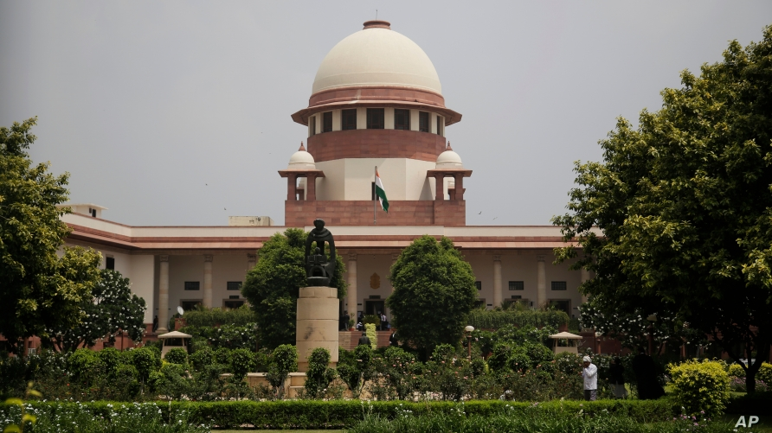


A BIG CHEERS TO SUPREME COURT!

Slide 24
THANK YOU
G. Natarajan, Advocate, Swamy Associates
93400 54477 nuts@swamyassociates.com

